Slide 1
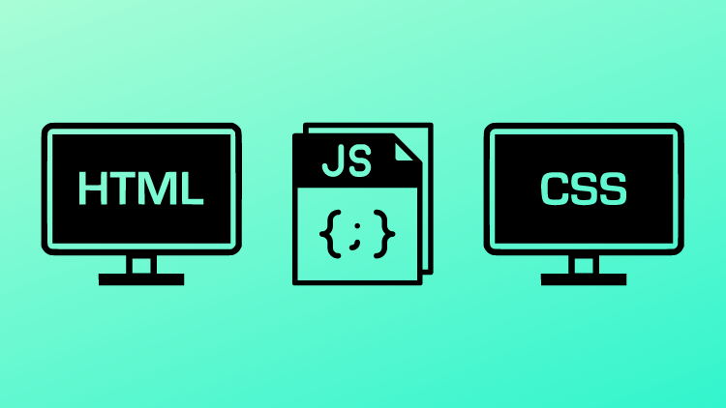
The Art of Doing
Web Development for Beginners!

Slide 2
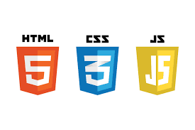
The Fundamentals of Web Development
In this course we will learn the fundamentals of web development:
HTML - The content on a web page.
CSS - The styling of content on a web page.
JavaScript - The functionality of content on a web page.

Slide 3

Learning HTML
We will cover the following HTML topics:
Heading and paragraph tags
Formatting text with various styling tags
List and Table tags
Tag Attributes
Anchor Tags
Image Tags
Various Input Tags
Form Tags
Proper HTML structure
Block Level and Inline Elements
Divs and Spans
Semantic HTML Elements

Slide 4

Learning CSS
We will cover the following CSS topics:
CSS Styling Rules
CSS Selector Methods
Element Width and Size
Defining Color
The Box Model
Styling Text
Styling Lists and Tables
Various Display Values (block, inline, inline-block)
Flexbox
Grid
Pseudo Classes
Transforms
Transitions
Animations

Slide 5

Learning JavaScript
We will cover the following JavaScript topics:
Declaring Variables
Various Data Types
Working With Arrays
For Loops and While Loops
Conditional Statements and Switch Cases
Writing Functions
Document Object Model
getElementById()
querySelector()
JavaScript Events
Getting values from Input Fields
Getting Values From HTML Forms

Slide 6
What I Craved In My Learning….
What I craved after learning a collection of new concepts was an example website to try and build.
I wanted a template, a challenge…”here is this site, now go see if you can build it.”
I wanted support so that if I struggled, I could see only what I needed to see and then be back on my way.
Lastly, I wanted an explanation of how all these seemingly isolated concepts came together and worked together to create the final product of the website.
I’ve worked really hard to try to give you that experience that I wanted so badly, here in this course.

Slide 7
How We Will Learn…
Over 10 sections I spend time first introducing various concepts. We discuss key ideas, syntax, and how to implement various HTML, CSS, and JavaScript concepts.
Then, at the end of each section I challenge you to recreate a website I have built using your knowledge up to that point in the course.
I give you all the assets, the color schemes, and walk through the thought process of what the website should look like and do.
Then, I leave it up to you to recreate it….or I challenge you to make something all on your own.
Lastly, I go through step by step how I built my sites, what design choices I made, and how and why I made them.

